Slide 1

Why Separate Code into Layers?

Slide 2






Separation provides options:

Slide 3

Separation is achieved by allow items to be decoupled:

Slide 4

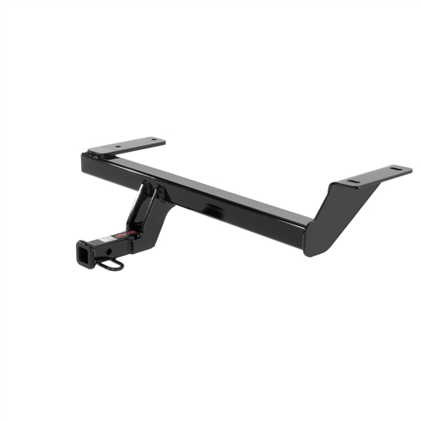
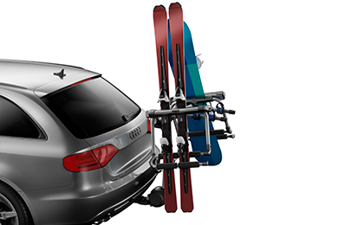


Addition levels of decoupling can add even more flexbility

Slide 5
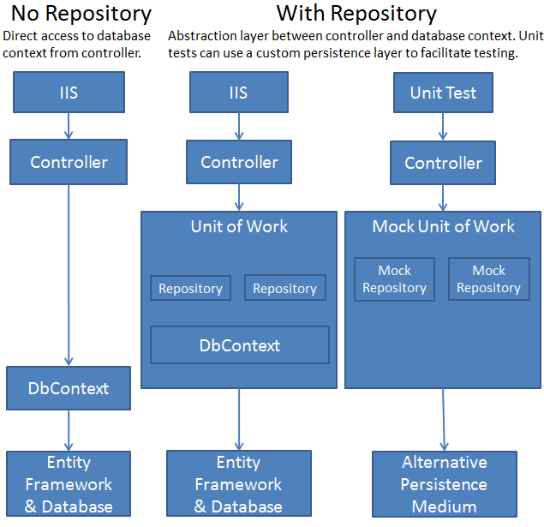

The same is true with code!

Slide 6
Timely tutorial more info:
http://www.asp.net/mvc/tutorials/getting-started-with-ef-using-mvc/implementing-the-repository-and-unit-of-work-patterns-in-an-asp-net-mvc-application

